Slide 1

Measuring Material Properties

Slide 2
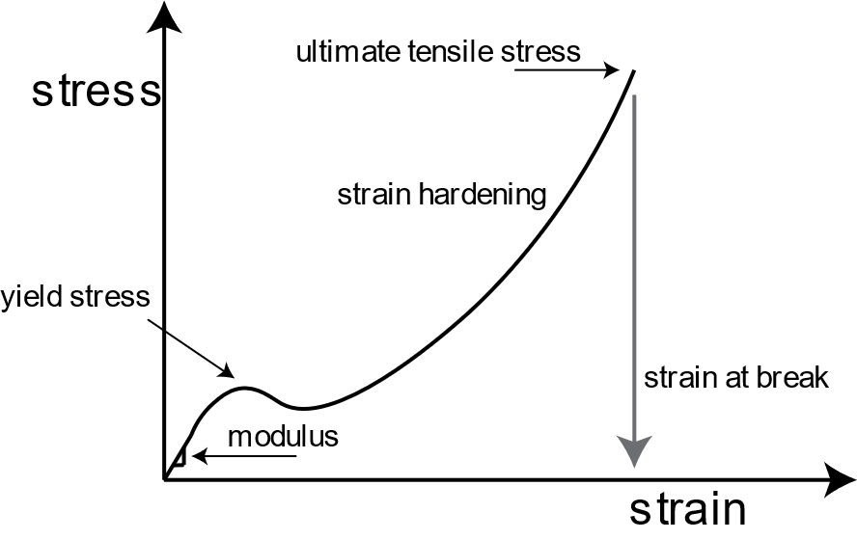
How can we measure how “strong” or elastic a material is?
Modulus of elasticity measures how much force is takes to stretch a material
Notes:
https://www.xometry.com/resources/materials/modulus-of-elasticity/

Slide 3
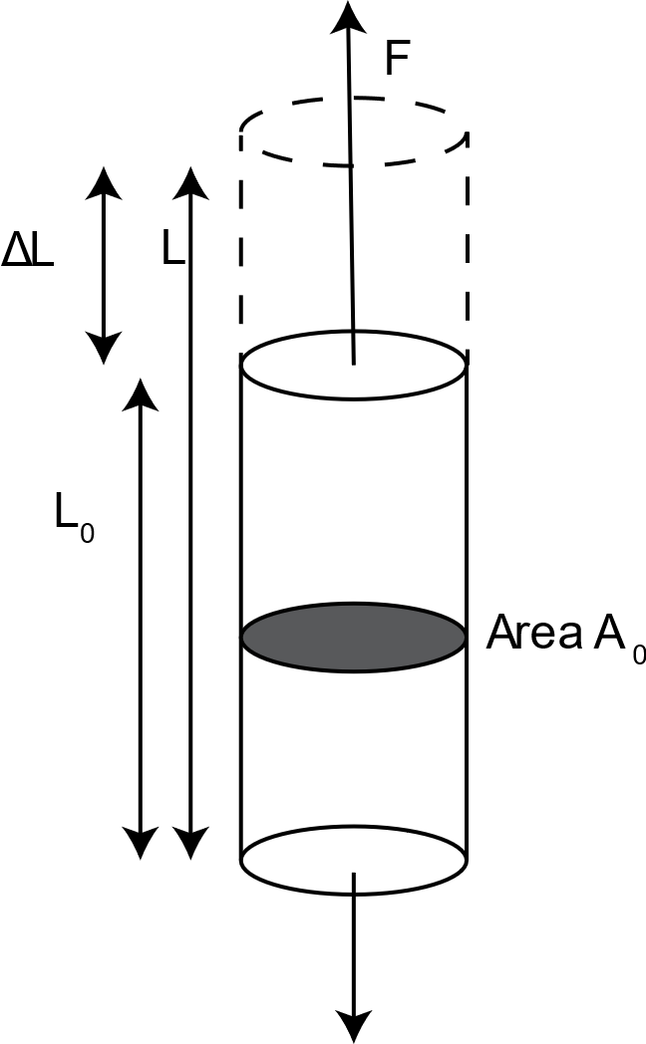
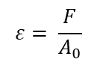
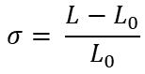
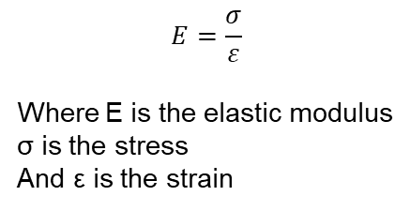
Calculating the Young’s Modulus or Elastic Modulus
$$E=\frac{σ}{ε}$$
Where E is the elastic modulus
σ is the stress
And ε is the strain
$$σ= \frac{L−L_{0}}{L_{0}}$$
$$ε= \frac{F}{A_{0}}$$
Notes:
https://cogripedia.com/engineering-stress/

Slide 4
Does a high or low modulus make a material stronger?

Slide 5
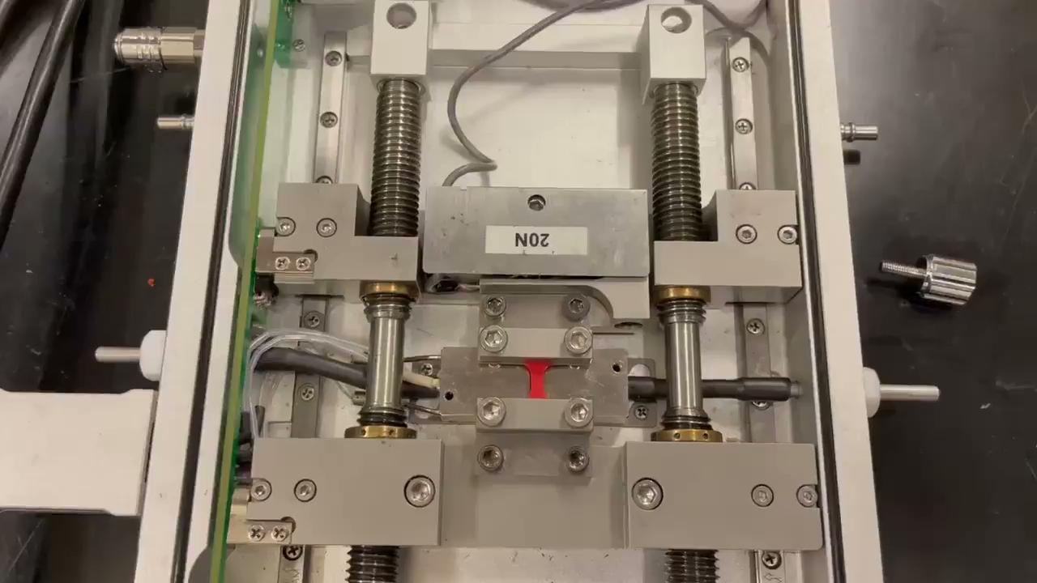
We use a tensile test and a ‘dumbell’ of our material to measure the modulus

Slide 6
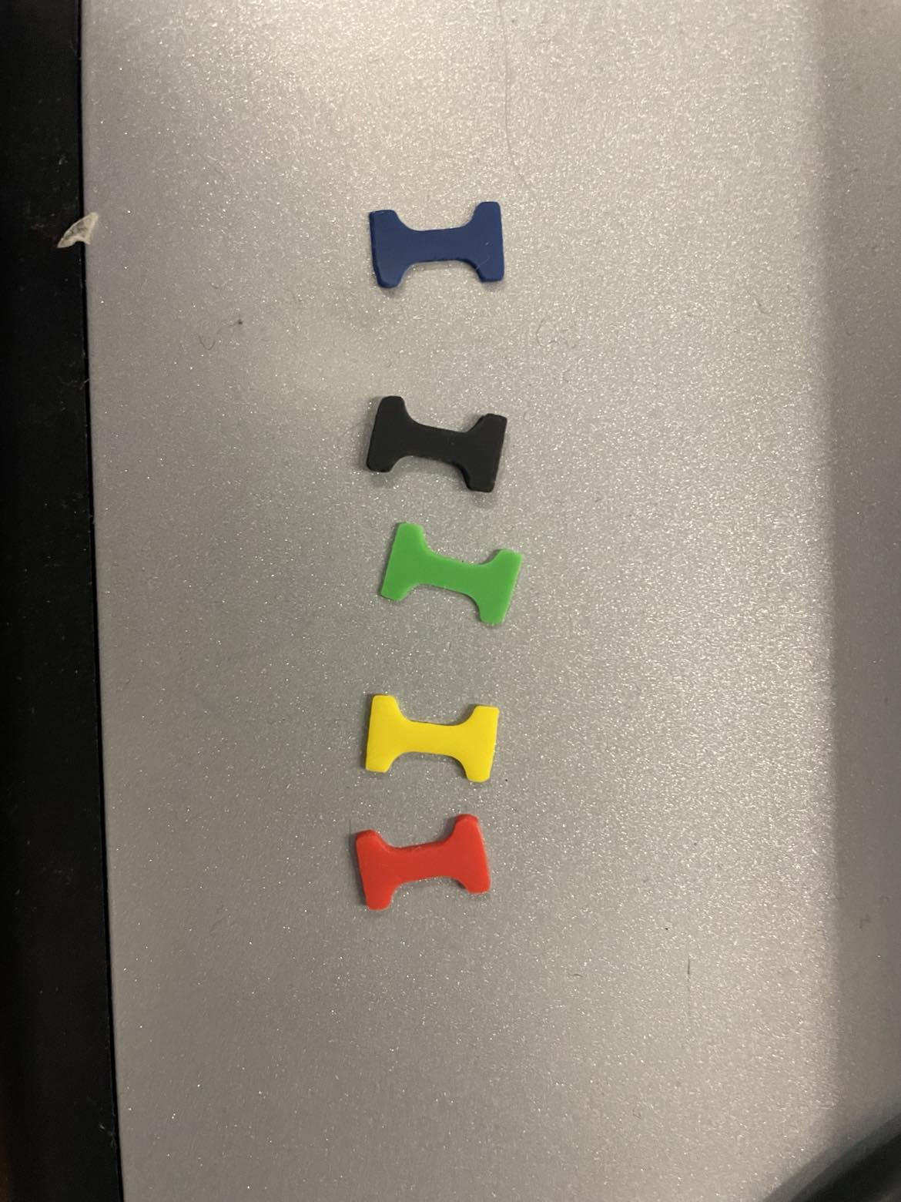
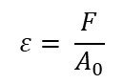
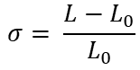
Using a dumbbell from each resistance band, calculate the band’s modulus!
Measure the length and thickness of your samples!
Pull the sample between the clamp and force gauge
Record the force and displacement for a few different lengths!
Calculate the stress and strain for each data point
Estimate the slope of the stress vs strain plot
The slope is the modulus!
$$σ= \frac{L−L_{0}}{L_{0}}$$
$$ε= \frac{F}{A_{0}}$$

Slide 7
Discussion
What modulus did you calculate for each band? Were they different or the same?
Are the bands made of different materials or the same material?
How can be tune the properties of an object (like a physical therapy band!) using information about physics and the material? Why is this important?

Slide 8
Results from the Tensile Tester!

